Slide 1

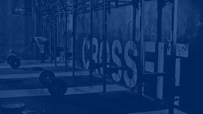

MUHAMMAD UMAIR SALIM
Data Analysis
Crossfit
INTERESTING INSIGHTS FOUND

Slide 2
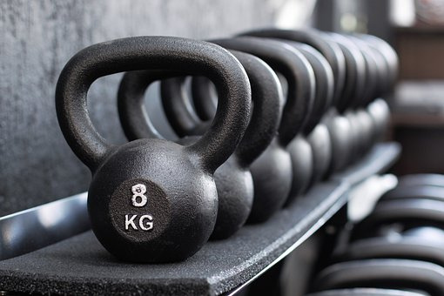
1
Introduction
CrossFit is a fitness regimen that has gained popularity in recent years due to its high-intensity workouts that combine weightlifting, gymnastics, and cardio exercises. CrossFit athletes are individuals who engage in this fitness program and participate in CrossFit competitions to showcase their skills and physical prowess. The CrossFit community is a rapidly growing and diverse group of individuals with varying levels of fitness and training backgrounds.
To better understand the characteristics and performance of CrossFit athletes, a comprehensive dataset has been collected from competitions and events around the world.
After conducting a thorough analysis of the available data, we have uncovered a number of compelling insights that we believe will be of great interest and value to our audience. The purpose of this presentation is to provide a concise overview of our findings, as well as to explain how these discoveries can be leveraged to drive meaningful outcomes and improve decision-making.

Slide 3

2
About Company
We are a forward-thinking brand, committed to revolutionizing the fitness industry with our innovative and cutting-edge products. Our aim is to empower individuals to achieve their fitness goals and lead healthier, more active lifestyles, and we do this by offering a diverse range of high-quality fitness equipment designed to meet the needs and preferences of every type of fitness enthusiast. As a newly launched brand, we are excited to expand our reach and bring our products to even more customers. With our passion for fitness and commitment to excellence, we are poised to become a major player in the fitness equipment industry and make a positive impact on the lives of individuals worldwide.

Slide 4
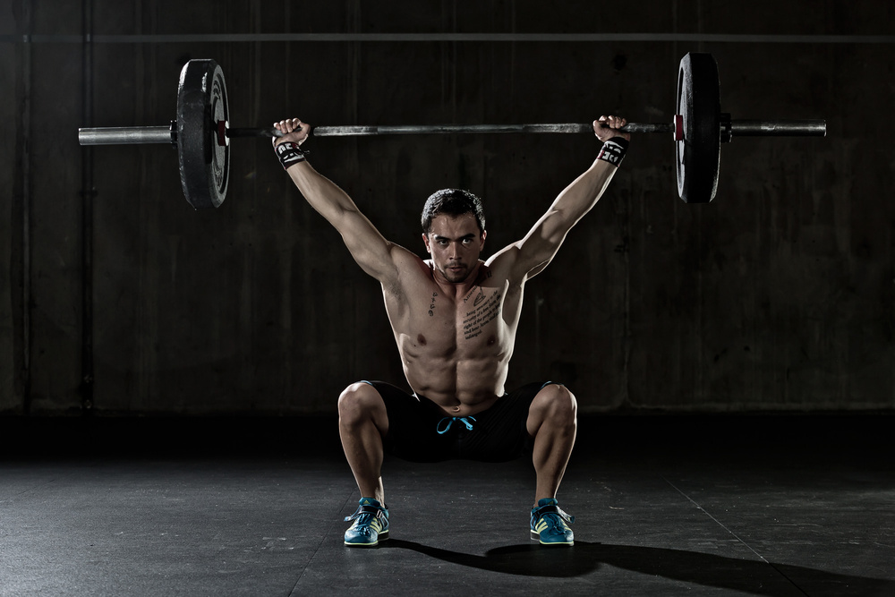

3
Our Target Future
Female Fitness Market
Weight Lifting Market
Fitness Center Market
Cardio market
Exploring fast growing female fitness market and uncovering new untouched regions
Drawing insights about the weight lifting enthusiasm and how can we target this already congested market.
Sponsoring new fitness centers can be a fast way of growing your fitness equipment business. Exploring regions where this can be an opportunity
Cardio market is not just a market for fitness equipment but also a very good place to sell health related items. We will be identifying new regions for this market

Slide 5





4
Female Participation
20.2 %
Female Fitness Market
20 %
19 %
16 %
It's fascinating to observe that the three regions that boast the highest participation rates among women in fitness activities, in descending order, are none other than Canada East, Southern California, and Mid-Atlantic. By targeting our female fitness equipment sales efforts towards these regions, we stand to gain the greatest traction among this highly engaged demographic. With this strategic focus, we can expect to witness a surge in demand for our fitness products, as we cater to the needs and preferences of these passionate fitness enthusiasts.
15 %
Asia
North central
Mid-Atlanctic
Southern California
Canada East

Slide 6

5
Weight Lifting Market
Weight Lifted According to Diet Plan
It turns out that individuals who neglect their diet are the ones who lift the most weights! With this in mind, we can adjust our marketing strategy for weight lifting equipment by honing in on the group of athletes who don't prioritize their dietary habits. By targeting this specific segment of the market, we can effectively showcase our products' ability to enhance their lifting performance, despite their dietary shortcomings. This is a unique opportunity to tap into an untapped market, and we're confident that our tailored marketing approach will resonate with this group, ultimately resulting in greater sales and brand loyalty.
No Diet
Strict Diet
Normal Diet
Other

Slide 7
6
EUROPE
AFRICA
AUSTRALIA
CALIFORNIA
LATIN AMERICA
CENTRAL USA
Fitness Center Market
It's intriguing to note that despite the fact that athletes in Africa have demonstrated a remarkable ability to lift heavy weights, indicating a clear passion for sports and fitness, there are actually very few fitness centers in the region. This represents a significant untapped market for fitness centers and presents a unique opportunity for increased sales of fitness equipment. With this newfound understanding of the market, we can leverage our products and services to help meet the growing demand for fitness facilities in Africa, empowering individuals to achieve their fitness goals and creating a healthier, more active community in the process.
Max Weight Lifted by Region

Slide 8
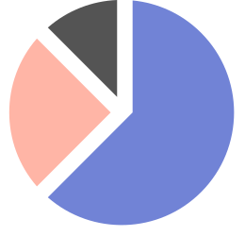



7
Highest Score in Cardio
Cardio Market
Our analysis has uncovered an exciting insight: the Mid-Atlantic and Northwestern regions of the country exhibit the highest levels of engagement in cardio workouts, signaling a clear passion for cardiovascular fitness in these areas. This is a strong indicator that these regions represent a fertile market for cardio-related fitness and health equipment. By capitalizing on this trend and directing our marketing efforts towards these regions, we can tap into the fervent interest in cardiovascular health and position our products as the go-to solution for achieving optimal cardiovascular fitness. With our eyes firmly set on these dynamic markets, we are poised to take the fitness industry by storm and help individuals achieve their health and fitness goals.
MID-ATLANTIC
NORTH
WEST
NORTHERN
CALIFORNIA

Slide 9

MUHAMMAD UMAIR SALIM
Thank You

